Slide 1


PRIMARY CARE 101
Lindsay Johnston
Executive Director, GBOHT
May 2026

Slide 2
Primary Care (PC) and Primary Care Provider (PCP)
PC - Continuous, comprehensive health care for individuals and families. Includes diagnosis, treatment, health promotion, disease prevention, and coordination of other health services. Often received through a Medical Clinic/Doctor’s Office, Family Health Team, Community Health Centre, Indigenous Primary Health Care Organization, Nurse Practitioner Led Clinic.
PCP – Health care provider who manages a patient’s existing health issues and is usually the first contact for patient seeking access to the health care system (Family Doctor or Nurse Practitioner).

Slide 3
Funding for Primary Care
Ministry of Health (MOH) – Portion of the provincial government in Ontario that governs health care and health promotion/prevention.
  Physician groups operate under provincial agreements with MOH
  Payment and practice rules for FHOs are set through the Physician Services Agreement (PSA) between MOH and the Ontario Medical Association (OMA)
Ontario Health (OH) – The government agency in Ontario responsible for overseeing health care delivery, improving clinical guidance and providing support for providers to ensure better quality care for patients.
  Health Service Organizations (including Primary Care Organizations) are funded through OH
  OH is split into regions. Grey Bruce is part of the West Region and receives guidance and direction from OHW.
Ontario Health Insurance Plan (OHIP) – Ontario’s publicly funded health insurance program that pays for medically necessary physician services, hospital care, and some diagnostic tests for eligible Ontario residents. Administered by the provincial government (Ministry of Health/Ontario Health), OHIP covers visits to family doctors and specialists, inpatient and outpatient hospital services, certain surgeries and diagnostic imaging.
  Family Doctors utilize billing codes to bill OHIP for patient care services.

Slide 4
Family Doctors
Family Health Organization (FHO) – A collaborative primary care model where three or more family physicians work together, offering comprehensive primary care services . Physicians receive a flat monthly capitation payment for each patient they have on their roster which forms the majority of their income.
  Family Health Groups (FHG) and Family Health Networks (FHN) are previous iterations of FHOs. Some still exist locally.
  The majority of physicians in Grey Bruce other than those at the Sauble FHT, IPHCOs and SEGCHC are part of one of these three models.
Fee for Service (FFS) – Payment model for physicians where they are paid for each patient visit or service rendered.
  There are two physicians in Grey Bruce who bill FFS and are not part of a physician group, SFHT, or SEGCHC
Blended Salary Model (BSM) – Physicians in this model receive a combination of salary and billings.
Salaried Physicians – Physicians who receive a salary, benefits, and vacation. They cannot bill OHIP.
  SEGCHC and IPHCO Physicians

Slide 5
Nurse Practitioners (NPs) in Ontario
Role and Clinical Scope
Autonomous Practice: Independently diagnose, treat, and manage acute and chronic medical conditions, can sign medical certificates of death and perform MAiD.
Full Prescribing Authority: Authorized to prescribe medications, including controlled substances.
Diagnostic Power: Order and interpret laboratory tests, X-rays, ultrasounds, CT scans, and MRIs.
System Navigators: Perform medical procedures and refer patients directly to medical specialists and consultants.
Diverse Integration: Lead and work collaboratively within teams in a variety of clinical settings including NPLCs. hospitals, virtual care, primary care, correctional facilities, walk in clinics and long-term care
Education
Nurse Practitioners in Ontario have a minimum of 8 years of nursing education and clinical experience.
Nursing Foundation: Must hold a 4-year Bachelor of Science in Nursing (BScN) and register as an RN.
Clinical Experience: Minimum of two years (3,640 hours) of full-time practice as a RN required.
Advanced Degree: A post-graduate Master’s degree and a Graduate Diploma in advanced practice nursing. (2-3 years combined post-graduate education).
Licensure Exam: Pass an approved, rigorous NP registration exam to be certified by the College of Nurses of Ontario (CNO).
Strictly Regulated: Must meet educational requirements, pass licensing exam. register with the College of Nurses of Ontario (CNO) and meet yearly continuing education and Quality Assessment requirements.
(CNO, 2026; NPAO, 2025)
Notes:
College of Nurses of Ontario. (2026). Practice Standards: Nurse Practitioners. CNO. Nurse Practitioner
Nurse Practitioners' Association of Ontario. (2025). What is a Nurse Practitioner. NPAO. What is a Nurse Practitioner? – NPAO

Slide 6
Funding for NPs
Ministry funded salary
Integrated into Primary Care through FHTs, NPLCs, CHCs, home & community services, hospital-based primary care/outreach programs
NPs can be self-employed and patients pay directly for services
NPs can provide services like medical aesthetics, which are not OHIP covered by physicians or NPs, and therefore are patient-paid
Currently no opportunity for OHIP billing, blended salary models, or other funding methods, which are available to physicians
Canada Health Act (CHA) Interpretation Letter
In January 2025, the Federal Government announced that the reinterpretation of the CHA requires provinces and territories to publicly insure "physician-equivalent services" provided by regulated health professionals like nurse practitioners, midwives, and pharmacists.
Effective April 1, 2026, patients to be able to access OHIP funded services by NPs without out-of-pocket costs
Ontario has missed the deadline to implement this change, and has until April 1, 2027 to develop a funding plan or face financial penalties applied to provincial health transfers for non-compliance

Slide 7
Primary Care Organizations
Family Health Team (FHT) – A not for profit primary health care organization that includes health care providers such as nurses, social workers, nurse practitioners, dietitians and many others who work with an affiliated physician group to provide comprehensive primary care to patients, families, and communities. Each FHT has programs and services that are designed to help meet local health and community needs. Each FHT has a Board of Directors composed of physicians and community members that guide strategy and direction.
  There are 5 FHTs in Grey Bruce → Kincardine FHT, Owen Sound FHT, Hanover FHT, Peninsula FHT, Brockton and Area FHT
Blended Salary Model Family Health Team (BSM FHT) – a FHT that has salaried physicians who can also bill OHIP for some services. Salaries for physicians are through agreements with OH.
  There is 1 in Grey Bruce → Sauble FHT
Community Health Centre (CHC) – A not for profit, community governed primary care organization that provides team based, interdisciplinary primary health care and health promotion services to local populations, especially people facing barriers to care.
  There is 1 in Grey Bruce → South East Grey CHC
Indigenous Primary Health Care Organization (IPHCO) – A not for profit, community governed primary care organization led by Indigenous Peoples that delivers culturally safe, holistic, primary health care services grounded in Indigenous models of health and self determination.
  There are 3 in Grey Bruce → Saugeen First Nation Health Centre, Noongwa Wellness, and SOAHAC
Nurse Practitioner Led Clinic (NPLC) → A provincially funded, community-based primary care clinic clinically led by nurse practitioners who provide comprehensive, team-based primary health care and health promotion.
  There is 1 in Grey Bruce → VON NPLC

Slide 8
Team Based Care
Interprofessional Care – When health care workers from different professions work collaboratively to deliver care, based on a patient’s needs and goals.
Interprofessional Health Provider (Allied Health) – Members of a care team including various regulated health care professionals and non-regulated health care professionals such as registered nurses (RN), registered practical nurses (RPN), nurse practitioners (NP), social worker, occupational therapist (OT), physiotherapist (PT), registered dietician (RD), midwife, health promoters, etc.
Interprofessional Care Team (IPCT) – A team composed of family physicians and/or nurse practitioners working together with other allied health providers and administrative professionals. Care from an IPCT can improve access and outcomes for patients and enhance clinical capacity and well being. For family physicians and nurse practitioners (prescribers), access to a team working to their full scope of practice can help support their ability to provide comprehensive, high-quality care and increase their capacity to attach more patients.

Slide 9
Primary Care Act, Primary Care Action Plan (PCAP), Primary Care Action Team (PCAT)
Primary Care Act – Provincial legislation recognizing primary care as the foundation of Ontario’s publicly funded health care system.
Primary Care Action Plan (PCAP) – Mandate: 100% of people in Ontario are attached to a family doctor or a primary care nurse practitioner working in a publicly funded team, where they receive ongoing, comprehensive, and convenient care.
Primary Care Action Team (PCAT) – Team led by Dr. Jane Philpott, who is responsible for implementing the Primary Care Action Plan, supported by an investment of >$1.8 billion over 4 years.

Slide 10
Primary Care Provincial Mandates
Attach 100% of Ontario residents to Primary Care by 2029.
Clear the January 1, 2025 Health Care Connect (HCC) Waitlist by June 2026.
Attachment to Primary Care – continuous, longitudinal relationship for comprehensive care, prevention, chronic disease management, and care coordination. Attachment can be to a Family Physician (Roster), Primary Care NP, or Primary Care Team (FHT, CHC, NPLC, IPHCO)
Health Care Connect (HCC) – A provincial service, offered through Ontario Health at Home (OH@H) that helps residents without a family physician or NP connect with one. HCC Care Connectors facilitate matching to local providers with capacity to take on more patients. Individuals must register with HCC to be matched.

Slide 11
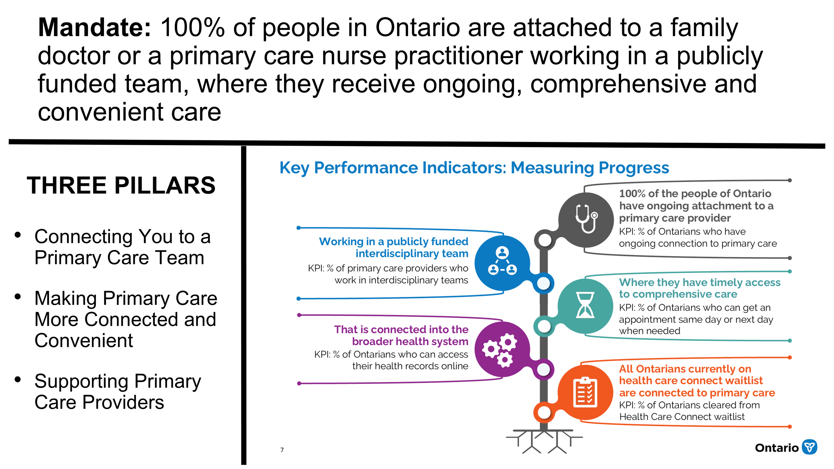
Interprofessional Care Team (IPCT) Expansion
Funding is for salaried primary care team staff.
One-time costs (capital and lease hold) are limited and max out at $100,000

Slide 12
Ontario Health Team (OHT) and Primary Care Network (PCN)
Ontario Health Team (OHT) – The new way of organizing health care. Preceded by the LHINs, this organization is more connected to the needs of patients, providers, and their local communities. OHTs operate through collaborative governance involving shared leadership inclusive of health service organization leaders, clinicians, and community members. The OHT is supported by a small group of dedicated staff who work with health, social, and community stakeholders on initiatives to support integrated care and provincial (OH/MOH) directions.
Primary Care Network (PCN) - The Grey-Bruce PCN brings together family physicians and nurse practitioners from across the region to strengthen collaboration, share expertise, and shape the future of healthcare in Grey-Bruce. The PCN is governed by the PCN Board that serves as the decision-making table for primary care in the GB OHT. Members meet monthly to identify priorities, address challenges, and co-design solutions that improve care for patients and providers.

Slide 13
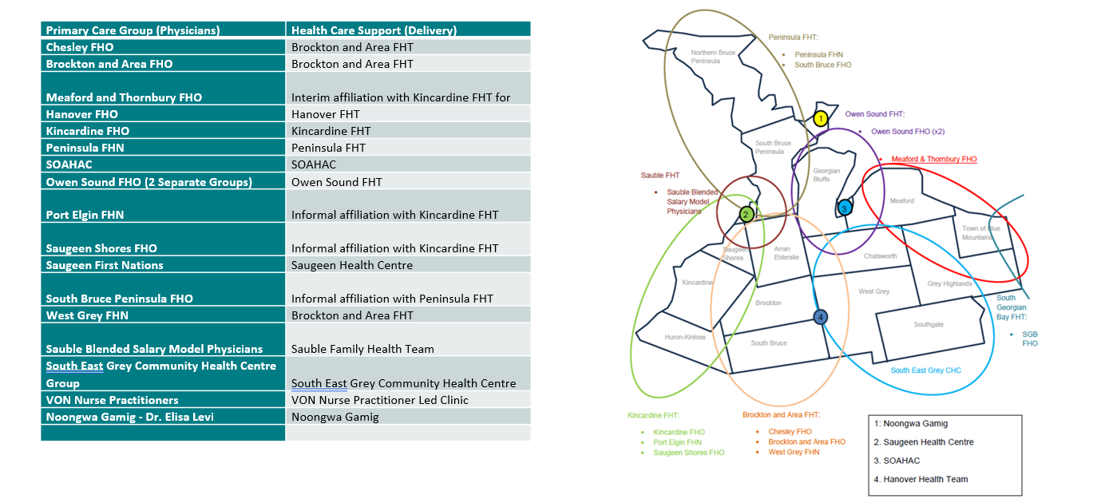
Primary Care in Grey Bruce

Slide 14
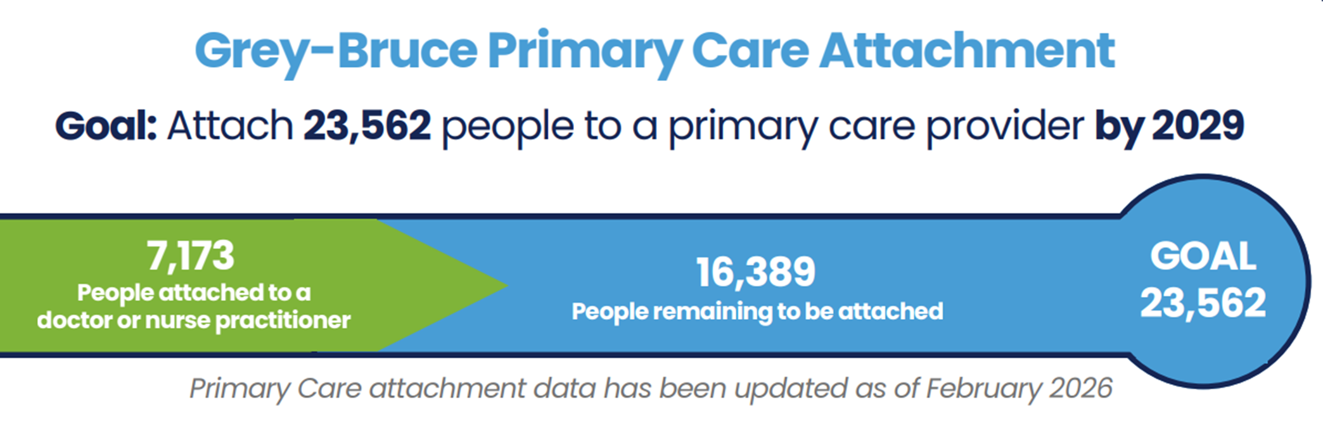
Progress to Date
$ 7,000,000 in base funding increase since August 2025
$4,000,000 additional required to achieve Master Plan
Additional 9,000 GB residents to be attached to primary care by April 2027
2 more opportunities to submit proposals for increased funding

Slide 15
What’s Next?
HCC Promotion
Allied Health Recruitment
Infrastructure
Attachment pathways
Change Management

Slide 16

Questions?

